Slide 1
Introduction to Uta Cloud
by Akshay Waikar

Slide 2
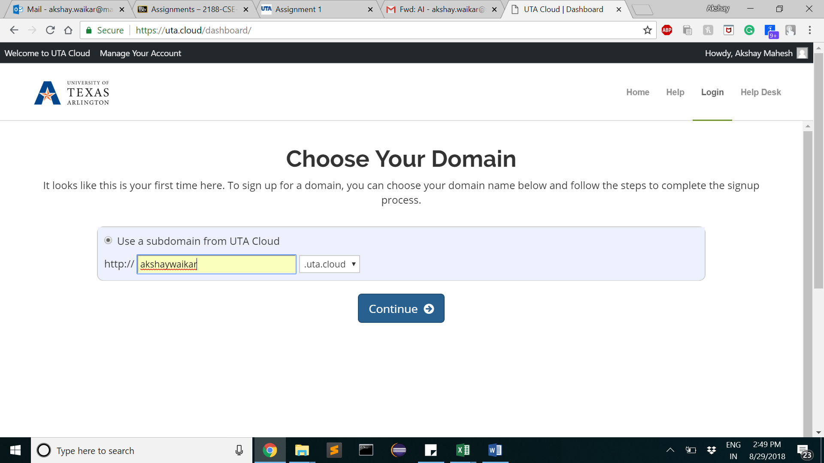
1. Go to https://uta.cloud, 2. Login with netID password

Slide 3
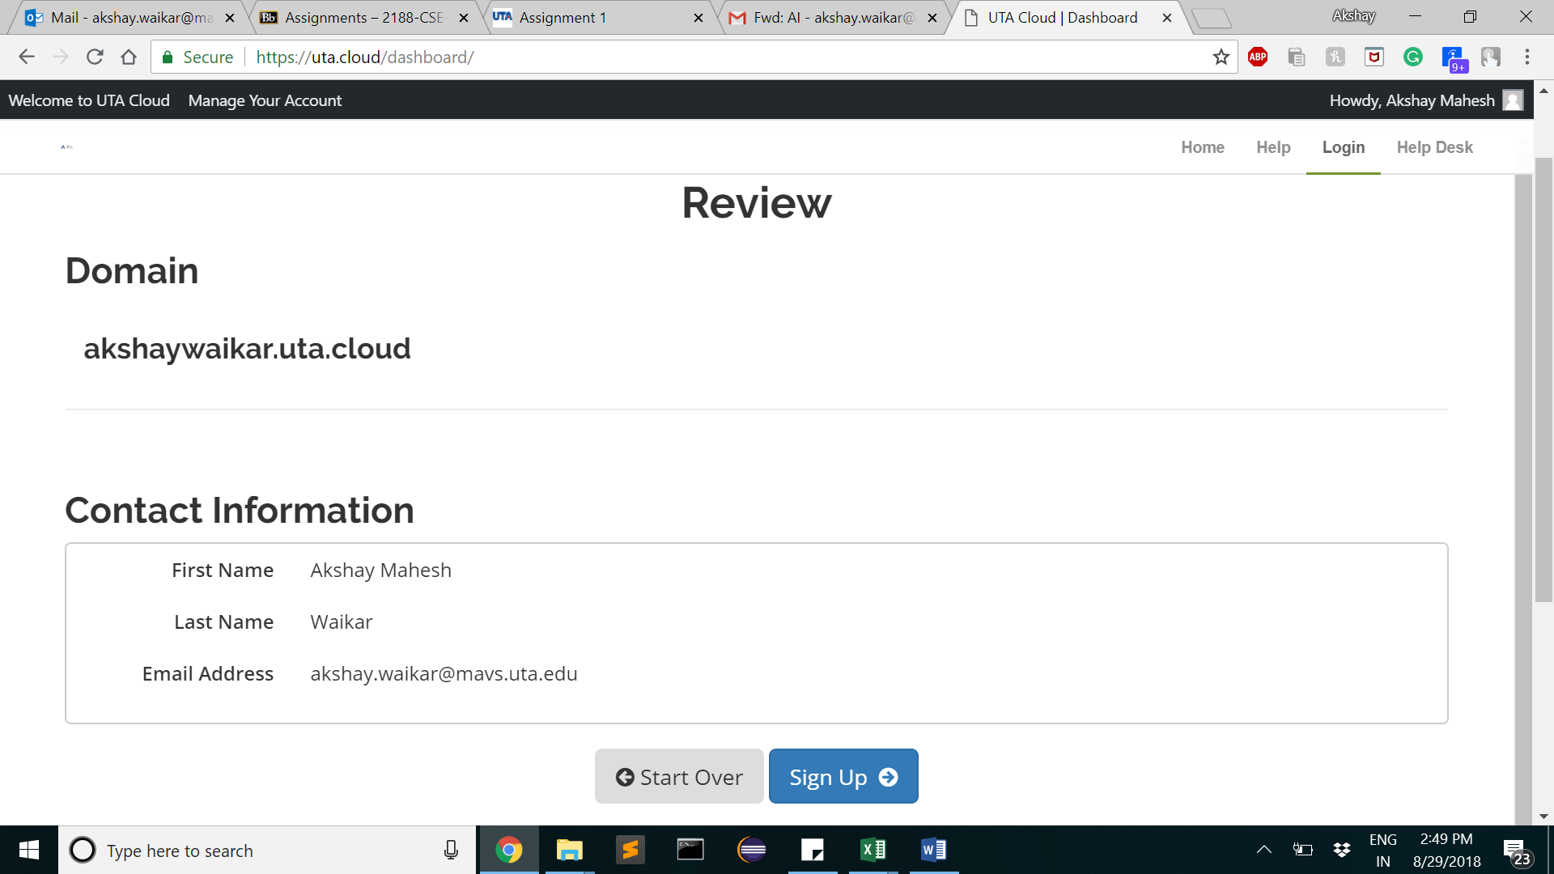
3. Click on Signup

Slide 4
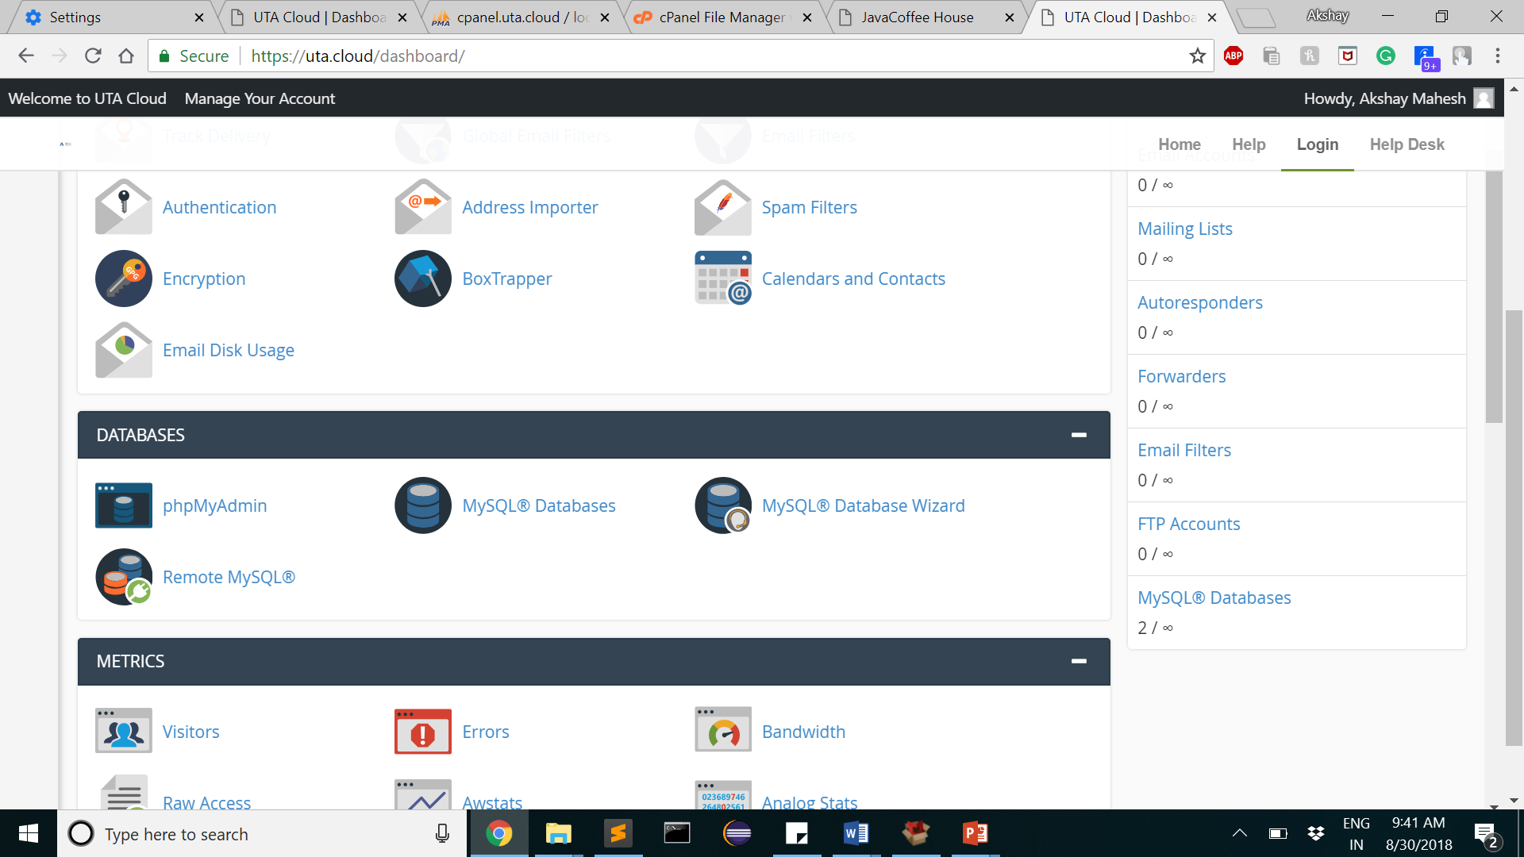
4. In dashboard, click on mySql database wizard

Slide 5
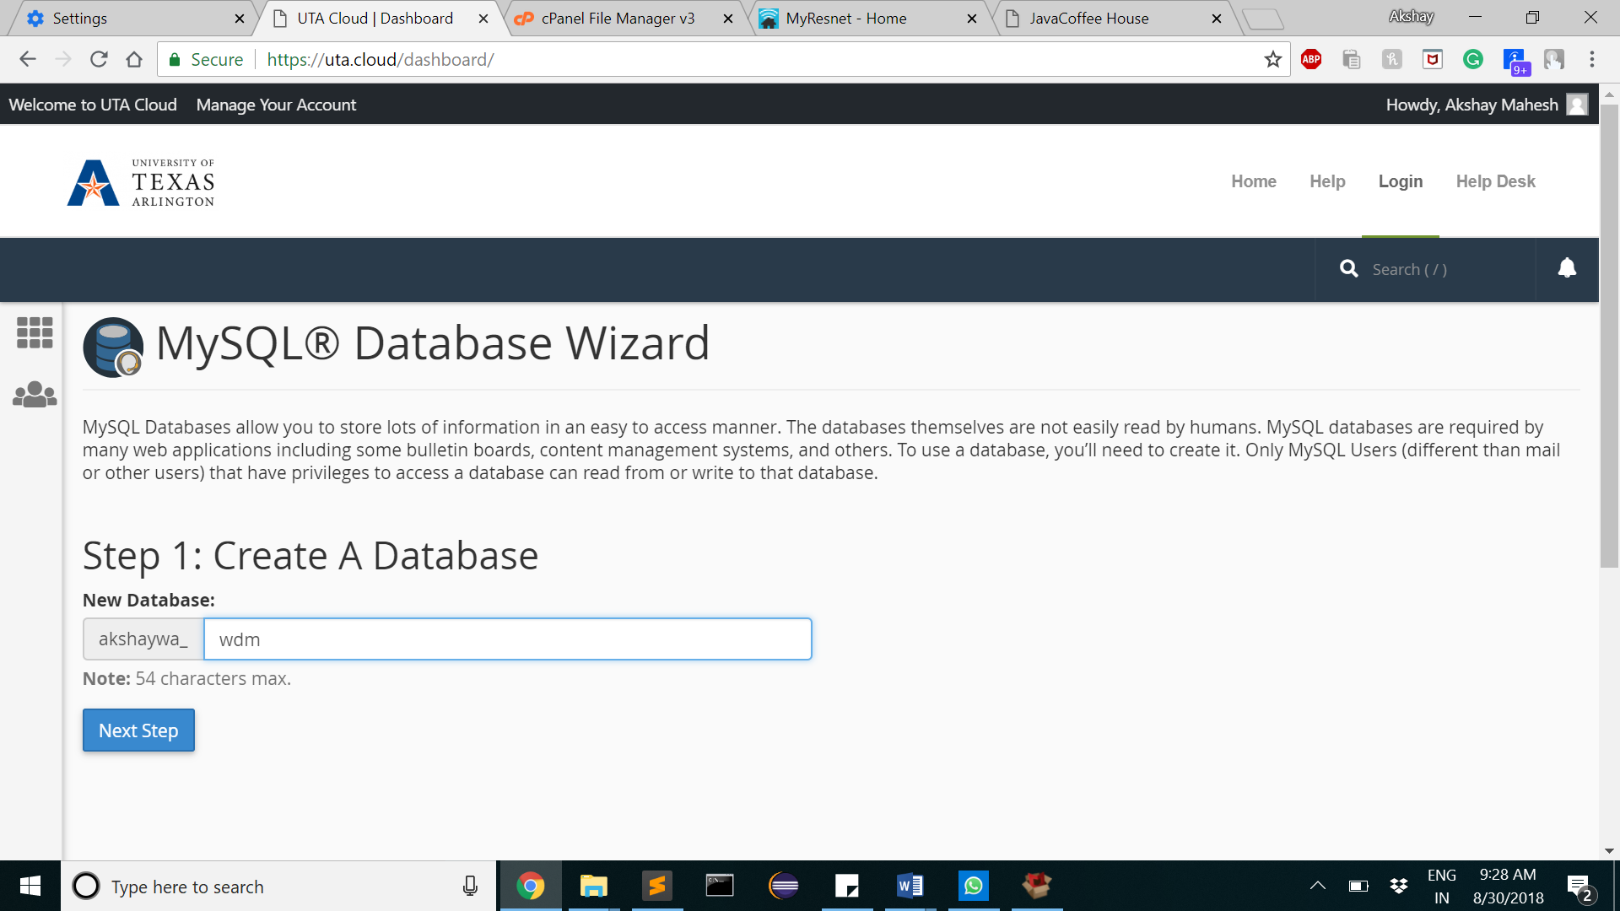
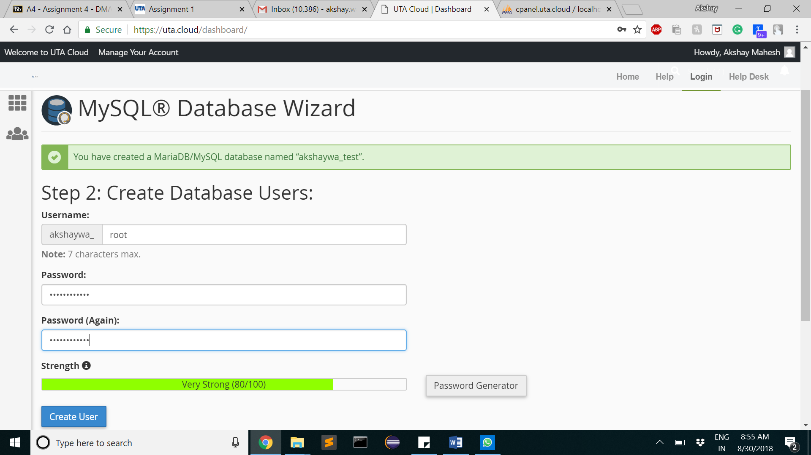
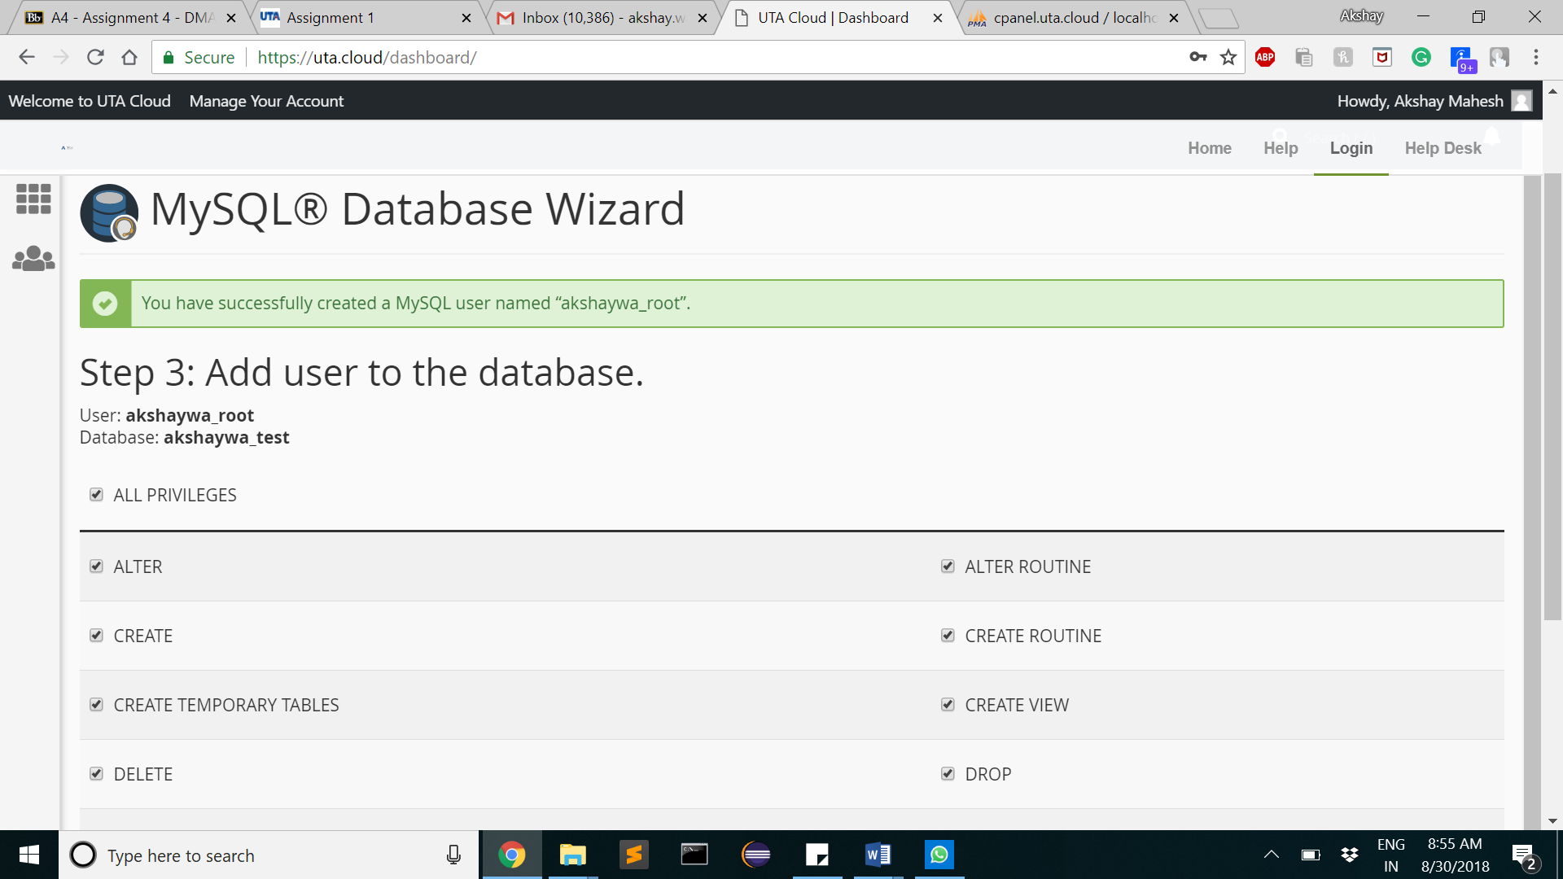
5. Creating database
Give db name
Click on all privileges
Give username and password
The database will now be seen in phpmyadmin

Slide 6
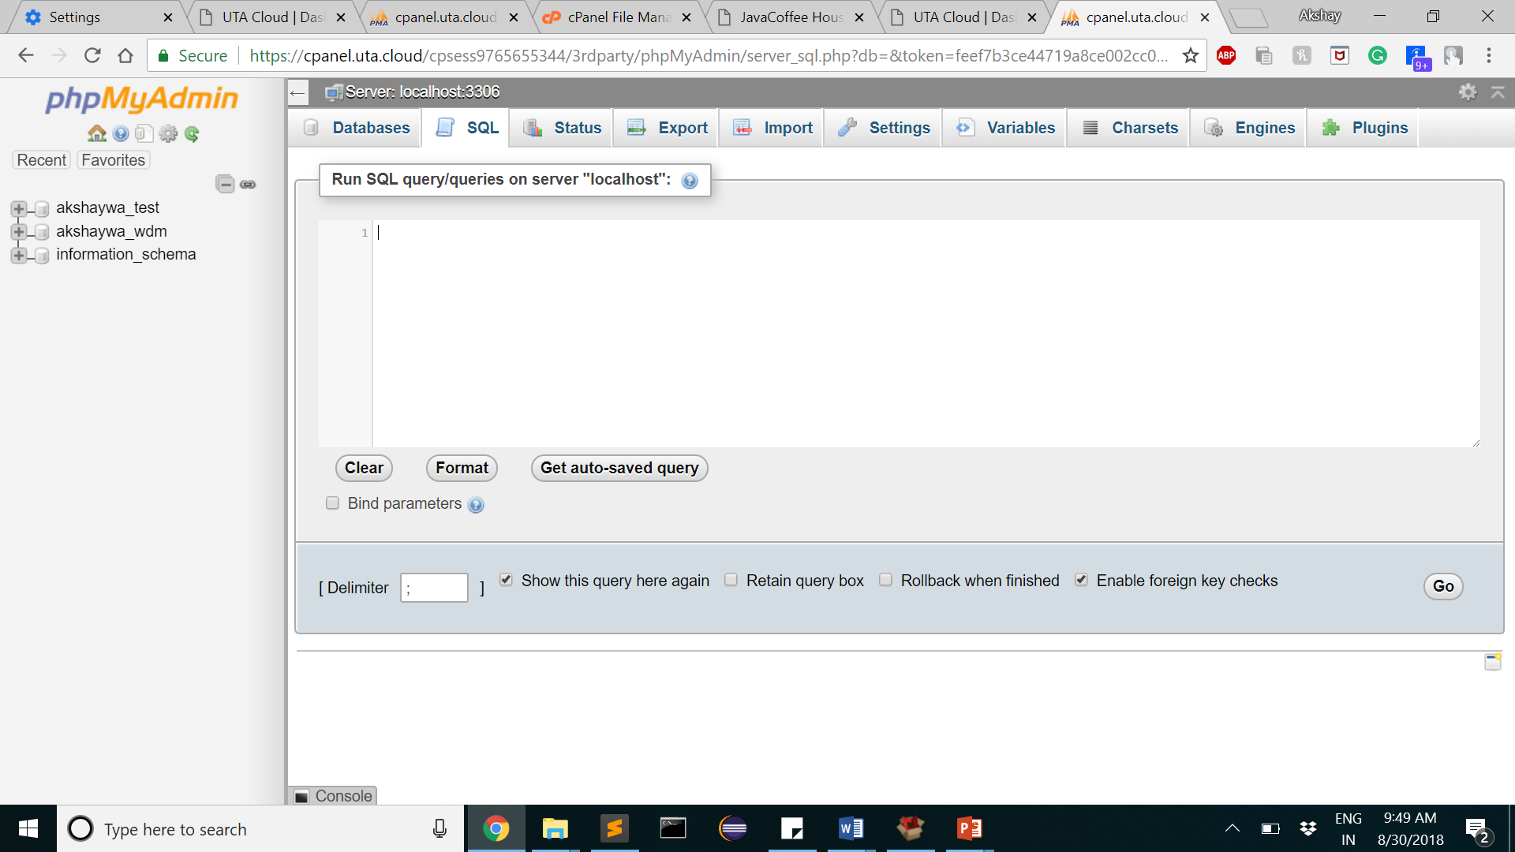
6. SQL queries

Slide 7
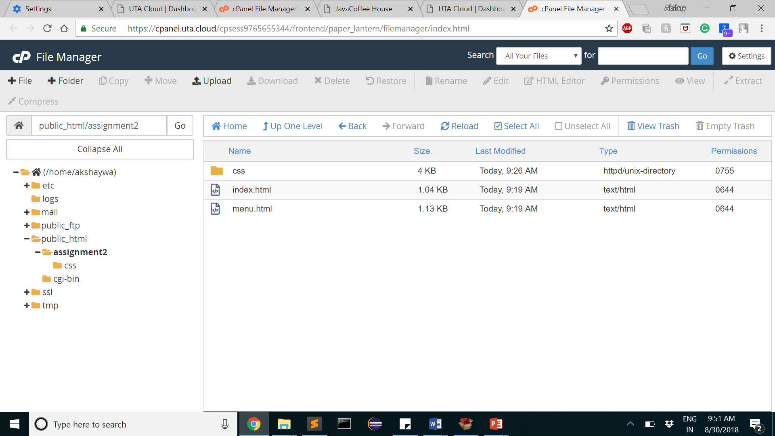
7. File manager->public_html->create your new folder
*The landing page is default.html inside public_html

Slide 8
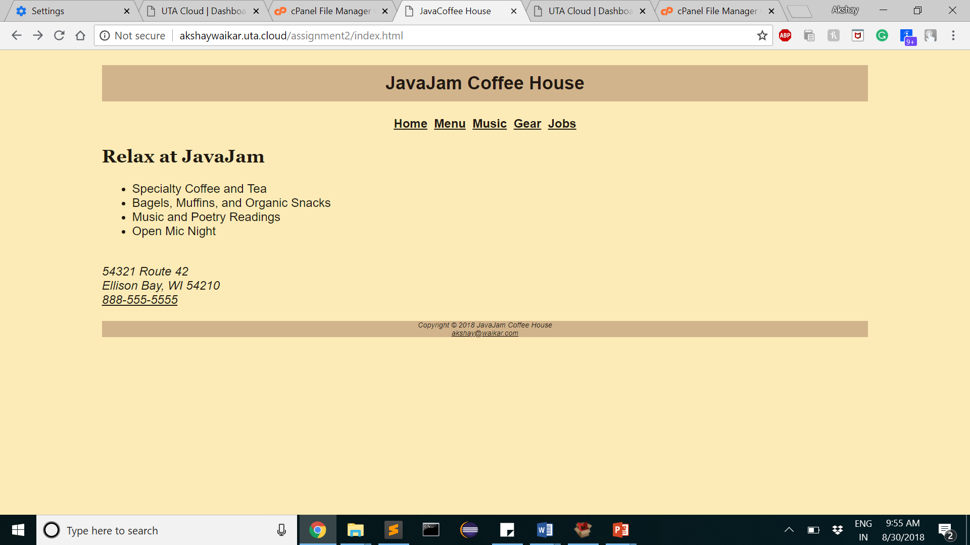
8. In Browser->your domain link/foldername/filename
Example : http://akshaywaikar.uta.cloud/assignment2/index.html

Slide 9
Thank you

